Slide 1
Lecture 6: Project Submission Method
Interactive Multimedia
Setting up: GitHub, GitHub Pages & button redirect to source code

Slide 2
Videos of live lecture
Part 1: https://web.microsoftstream.com/video/c7cc7e18-af5c-4ed3-9797-b5cc147e49f4
Part 2: https://web.microsoftstream.com/video/c595ff07-59fc-4db1-b067-557def5a916d

Slide 3
5 Major Steps
1. Setup GitHub account
2. Unity & GitHub
3. Add button that navigates to URL
4. Build WebGL
5. Host with GitHub Pages

Slide 4
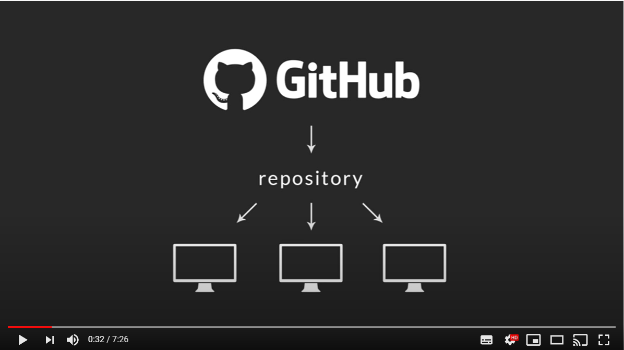
Video covering first 2 steps
A short video tutorial which covers Steps 1 & 2 is available here: https://youtu.be/qpXxcvS-g3g
Setup GitHub
Get a Unity project
working with GitHub

Slide 5

Step 1
Github setup

Slide 6
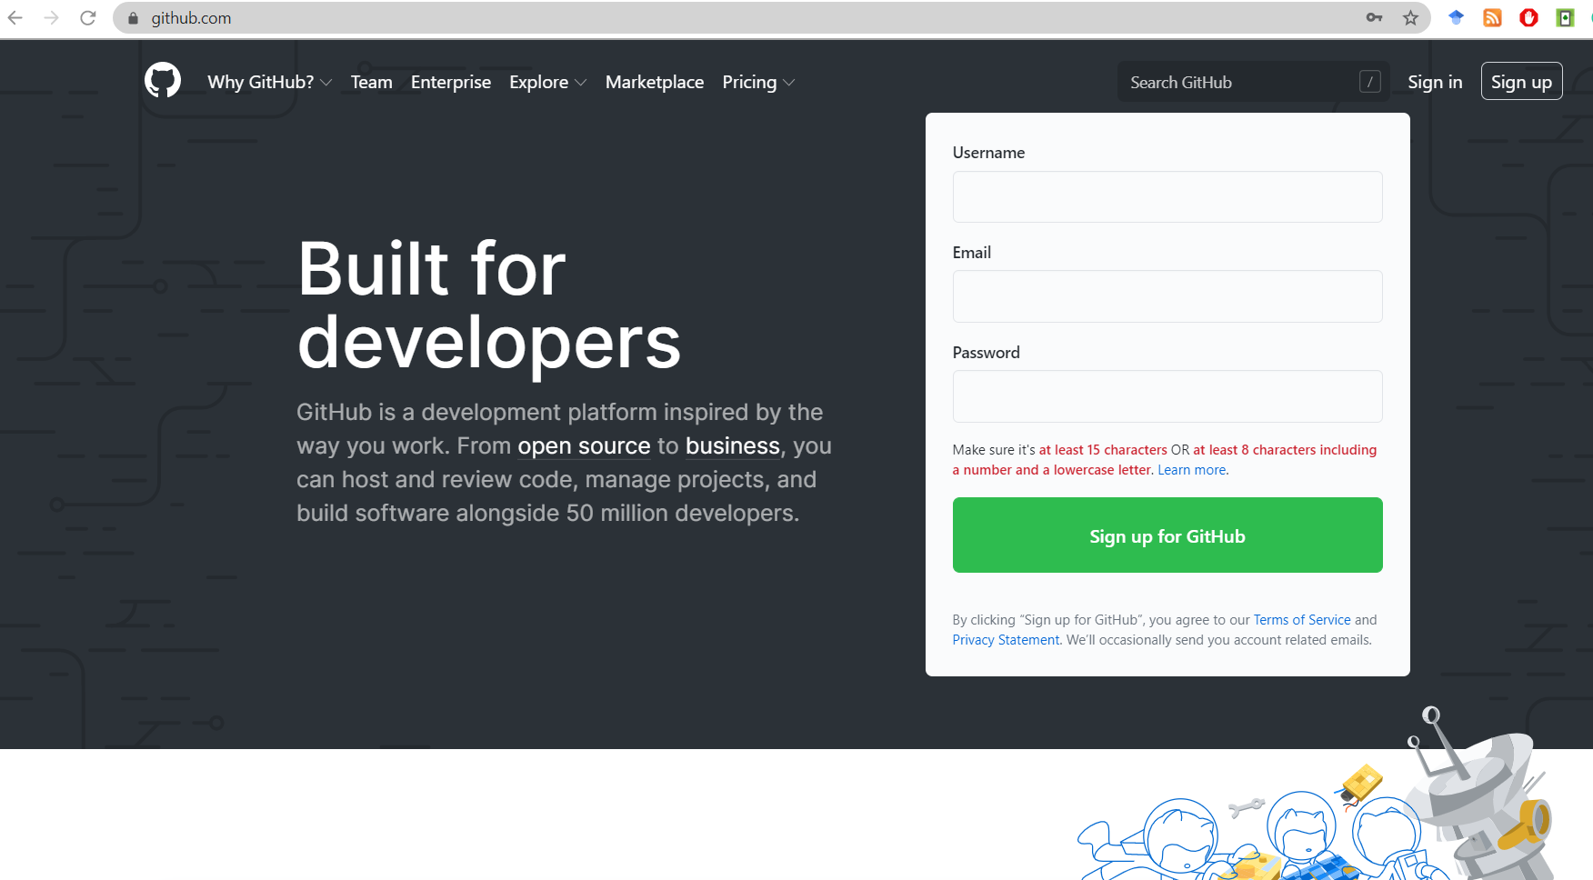
Setup GitHub Account
www.github.com

Slide 7
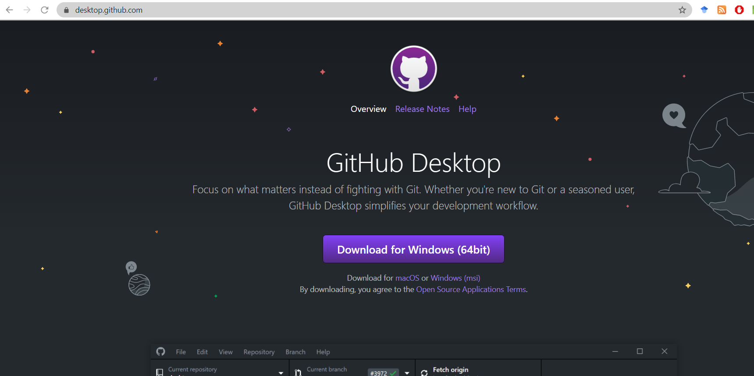
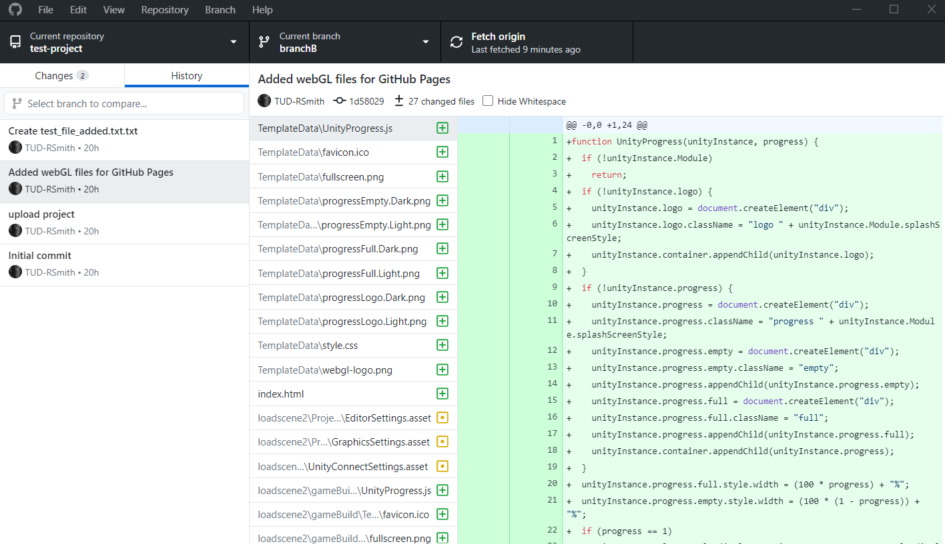
Download and install GitHub Desktop
https://desktop.github.com/

Slide 8
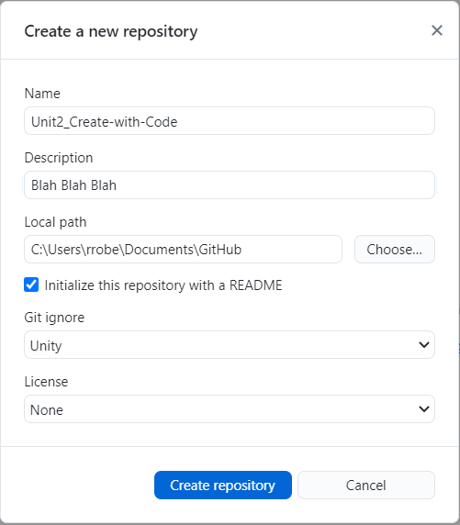
Create a new GitHub repository
Create in the GitHub folder on your local machine
Create a read me
Choose Git Ignore “Unity”
Commit and Push
Check your Repository on GitHub.com

Slide 9

Step 2
Github and Unity

Slide 10

Put files into GitHub repository
Simply create a new Unity project in your GitHub folder… its that easy
You could also copy and paste an old project

Slide 11
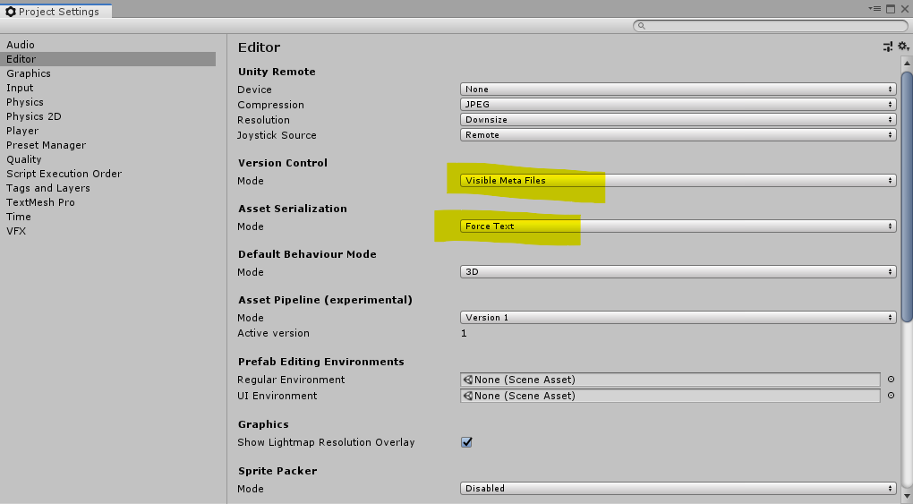
Change some Unity project settings
Edit>Project Settings>
set Version Control mode to : “Visible Meta Files”
set Asset Serialization mode to “Force Text”
When we go to commit, there seems to be a lot of files

Slide 12
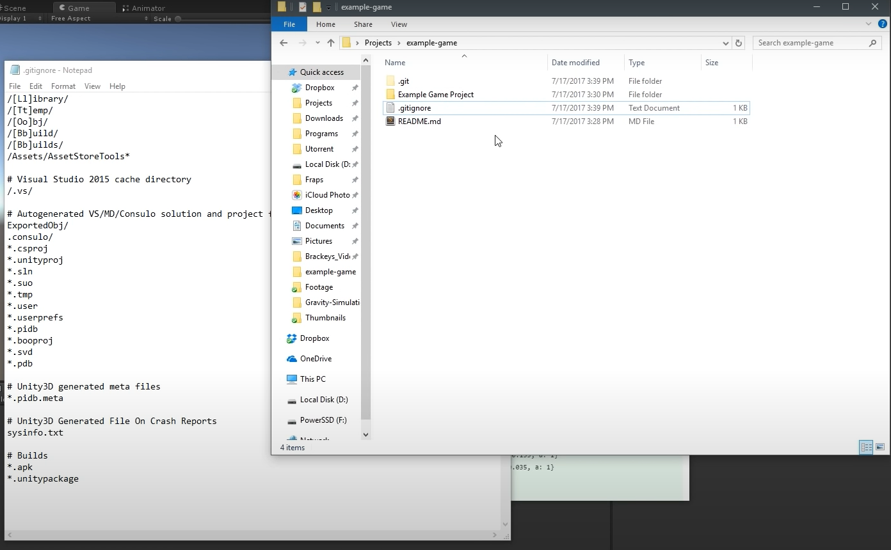
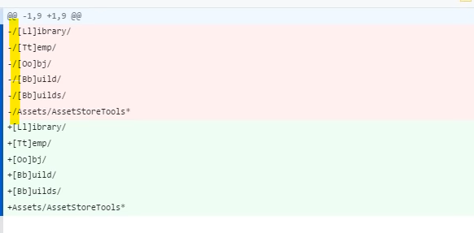
Edit the .gitignore file
If, at this stage we look at the repository on our local machine, we will see that there are 100s of files waiting to be committed.
This can be reduced by editing the “.gitignore” file
Remove the forward slash from the first 6 lines just lines (forward slash characters to be deleted are highlighted area on the image to the right)

Slide 13
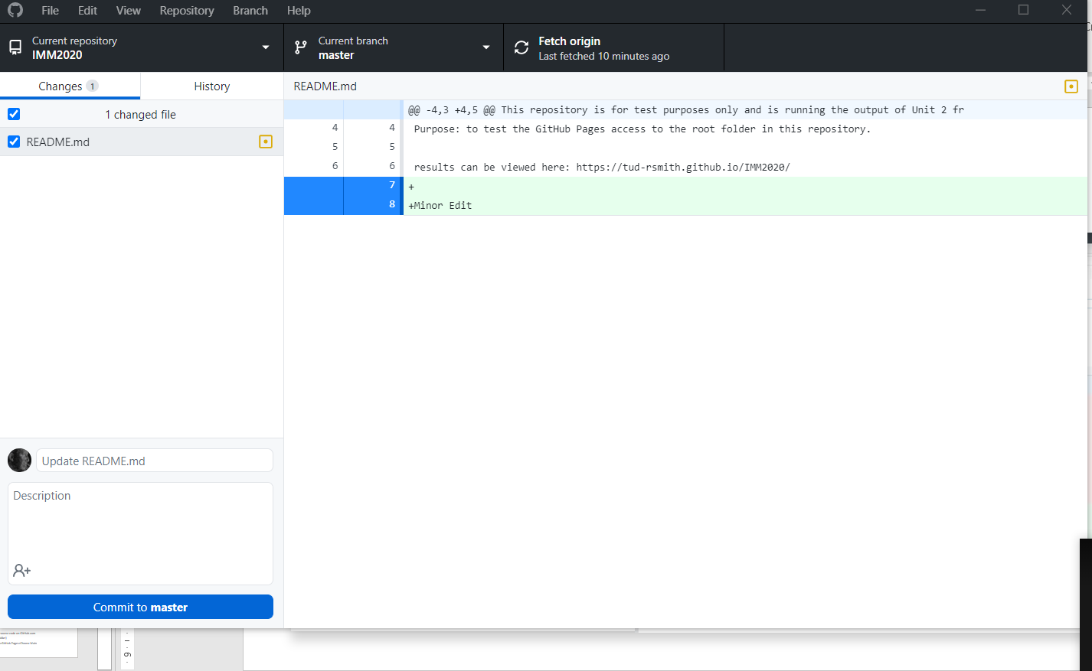
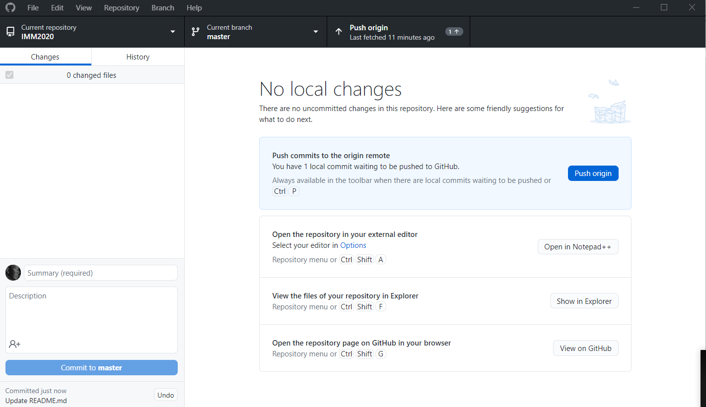
Commit & Push
Push
Commit

Slide 14
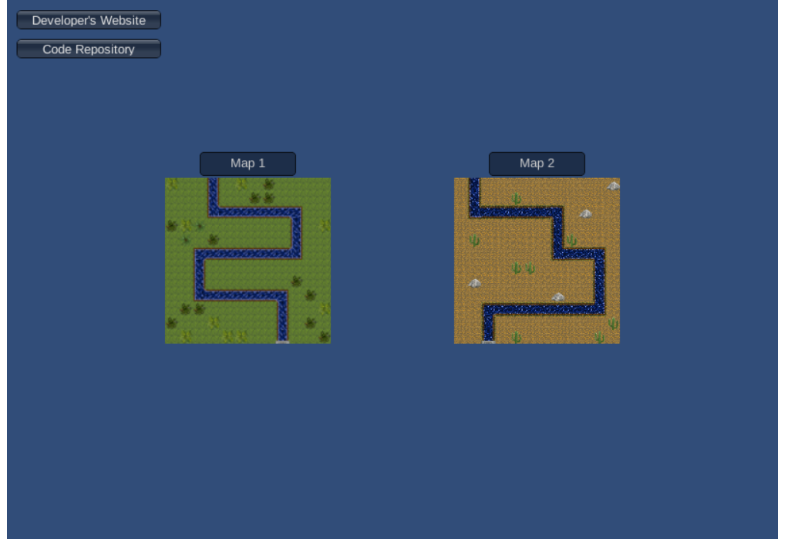
Step 3
Add URL button
https://andrew-boutin.github.io/tower-defense/

Slide 15

Create a new script & new button
Primary line of code is
Application.OpenUrl(“www.mysite.com”);
Short video tutorial: https://youtu.be/qqOqLNqAdDo

Slide 16
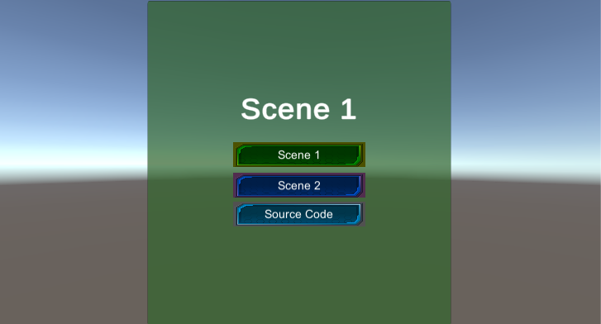
See example
https://tud-rsmith.github.io/Buttons-scenes-Url/

Slide 17
An example on local machine

Slide 18

Step 4
Build WebGL

Slide 19
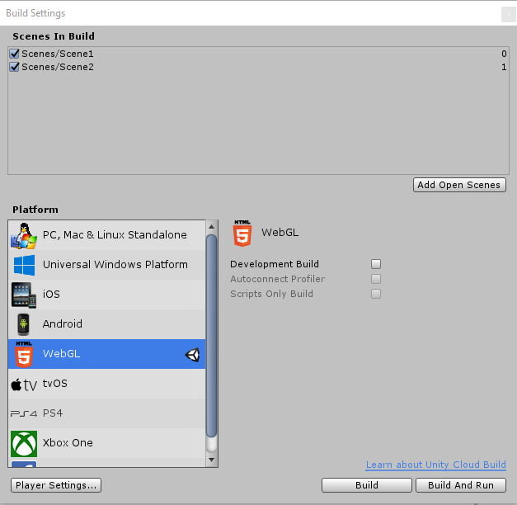
Build WebGL
File>Build settings
Make sure all scenes are included
Choose WebGL from the list
Click Build (takes some time)

Slide 20
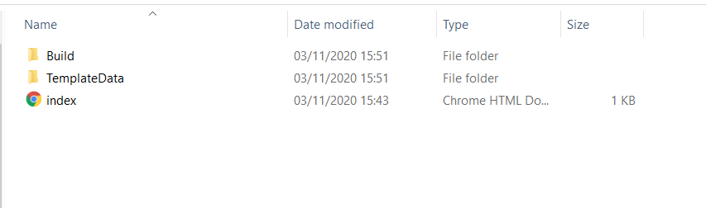
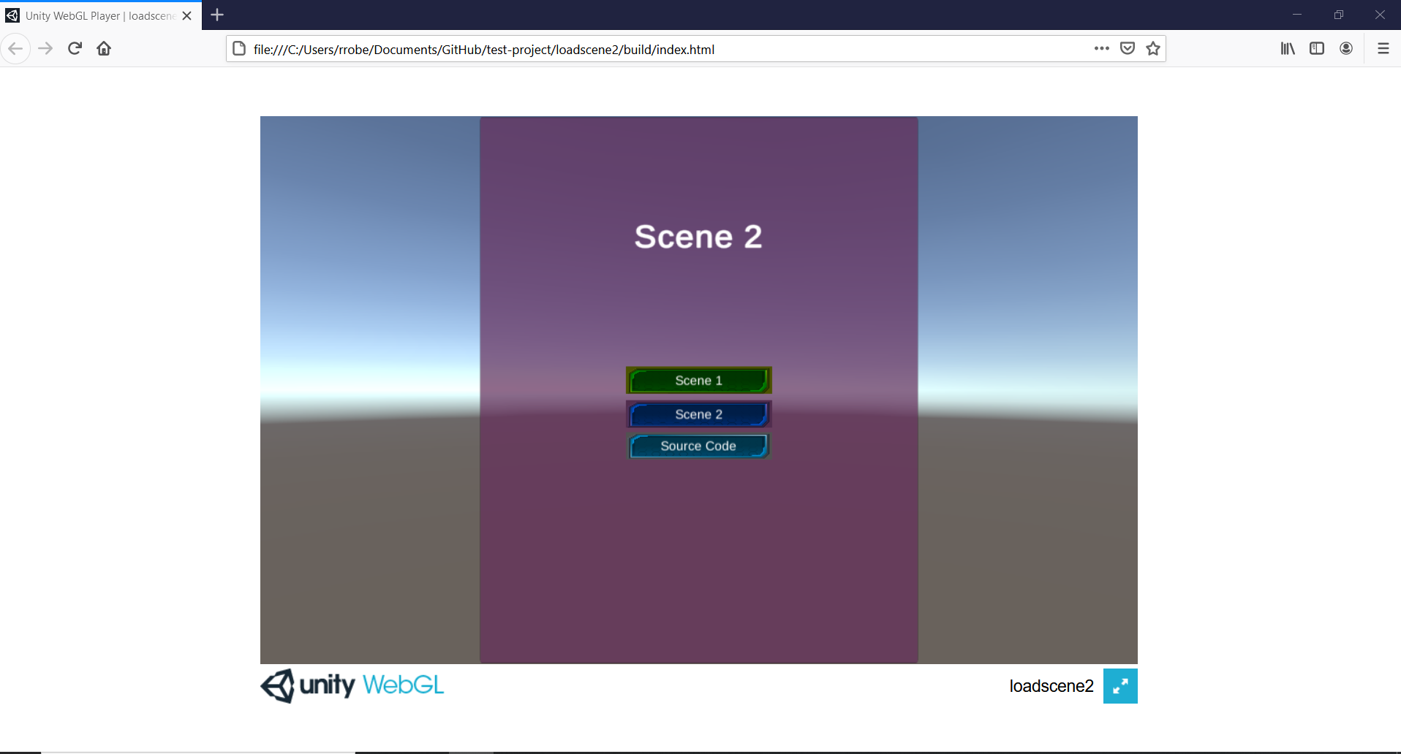
Completed WebGL build
Looks like this in the browser
Looks like this on local machine

Slide 21

Step 5
Github pages
Allows us to put a webpage online, the code for which can be hosted in a GitHub repository

Slide 22
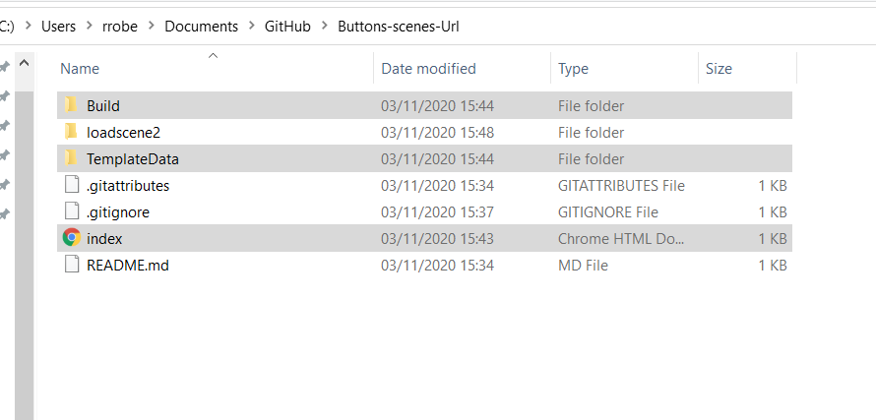
Move WebGL files
You need to copy the web files to the root folder of your repository

Slide 23
Commit & Push…again
Push
Commit

Slide 24
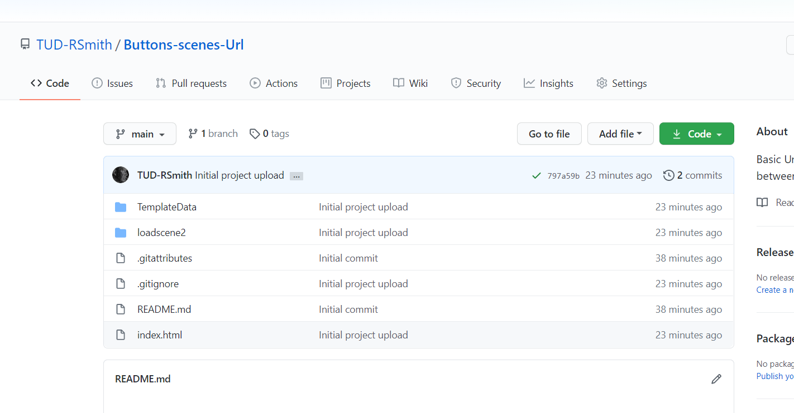
GitHub Pages
Got to your repository on GitHub.com
And choose Settings

Slide 25
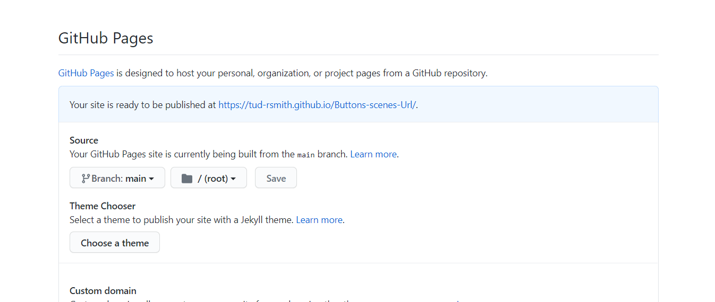
GitHub Pages
Scroll down to GitHub Pages
Chose “Main” as the source and click save.
You can now use the URL to go to your webpage
Go to the URL and playtest your game

Slide 26
Recap
Setup GitHub account
Download and install GitHub Desktop
Create a new GitHub repository
Create or copy/paste Unity project into the new repository
Edit>Project Settings>
set Version Control mode to : “Visible Meta Files”
set Asset Serialization mode to “Force Text”
Edit the .gitignore file
Commit & Push
Add URL button with navigates to your source code on GitHub.com
Build WebGL (save to repository root folder)
On GitHub website repository>Settings>GitHub Pages>Choose Main
Then save the link

Slide 27
Do this at least twice before your final submission
Get one of the Units from Create-with-code working on GitHub Pages
I recommend that you do this for multiple Units to get practice
Submit your Alpha version with this method
Submit your Final game version with this method

Slide 28
Basic 3D models for your project
Unity 3D primitives
Terrains
Asset store
1st and 3rd person controllers
Standard assets package
Pro Builder

